Slide 1
Photo Album
by Dell Vostro

Slide 3
Bill of Material for Chocolate Bar – 45g
Material Code | Material | Đơn vị tính | Số lượng nhập | Số lượng dùng | Đơn giá nhập | Tên Vendor
WHEAT-20 | Wheat | kg | 100 | 2 | 1500$ | Cereal Suppliers Ltd
OATS-20 | Oats | kg | 100 | 1 | 15000$ | Cereal Suppliers Ltd
SUGAR-20 | Sugar | kg | 100 | 1 | 1000$ | Spices Supplier Ltd
FLOUR-20 | Flour | kg | 100 | 1 | 1067$ | Spices Supplier Ltd
MILK-20 | Milk | L | 10000 | 2 | 199940$ | Beverage Supplier Ltd
WATER-20 | Water | L | 10000 | 2 | 50000$ | Beverage Supplier Ltd
OIL-20 | Oil | L | 10000 | 2 | 100000$ | Happy Market
BUTTER-20 | Butter | unit | 100 | 2 | 1500$ | Happy Market
EGG-20 | Egg | unit | 100 | 2 | 1000$ | Happy Market
PACKAGING-20 | Packaging | unit | 10000 | 2 | 200000$ | Packaging Supplier Ltd
GAS-20 | Gas | kg | 100000 | 2 | 3000000$ | Petrolimex

Slide 4
Bill of Material for Oats Bar – 40g
Material Code | Material | Đơn vị tính | Số lượng nhập | Số lượng dùng | Đơn giá nhập | Tên Vendor
WHEAT-20 | Wheat | kg | 100 | 2 | 1500$ | Cereal Suppliers Ltd
CHOCOLATE-20 | Chocolate | kg | 100 | 2 | 1940$ | Cereal Suppliers Ltd
SUGAR-20 | Sugar | kg | 100 | 2 | 1000$ | Spices Supplier Ltd
FLOUR-20 | Flour | kg | 100 | 2 | 1067$ | Spices Supplier Ltd
MILK-20 | Milk | L | 10000 | 2 | 199940$ | Beverage Supplier Ltd
WATER-20 | Water | L | 10000 | 2 | 50000$ | Beverage Supplier Ltd
OIL-20 | Oil | L | 10000 | 2 | 100000$ | Happy Market
BUTTER-20 | Butter | unit | 100 | 2 | 1500$ | Happy Market
EGG-20 | Egg | unit | 100 | 2 | 1000$ | Happy Market
PACKAGING-20 | Packaging | unit | 10000 | 2 | 200000$ | Packaging Supplier Ltd
GAS-20 | Gas | kg | 100000 | 2 | 3000000$ | Petrolimex

Slide 5
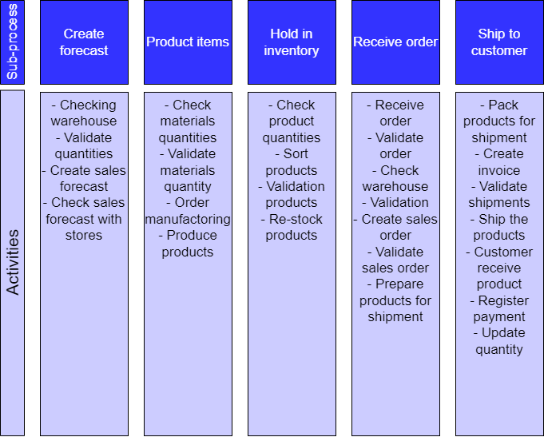
Purchase to Pay

Slide 6
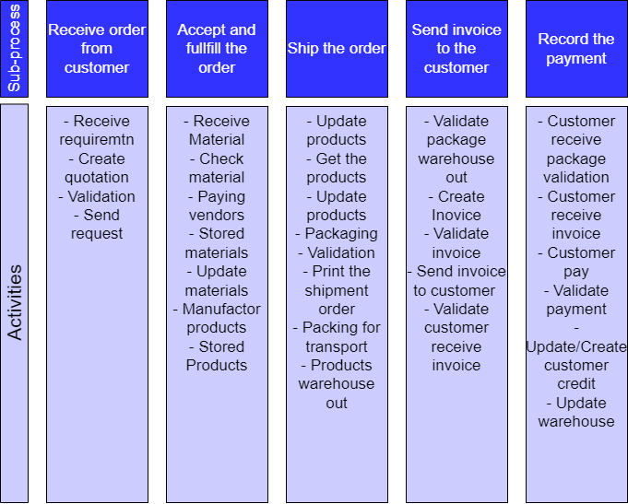
Order to Cash

Slide 7
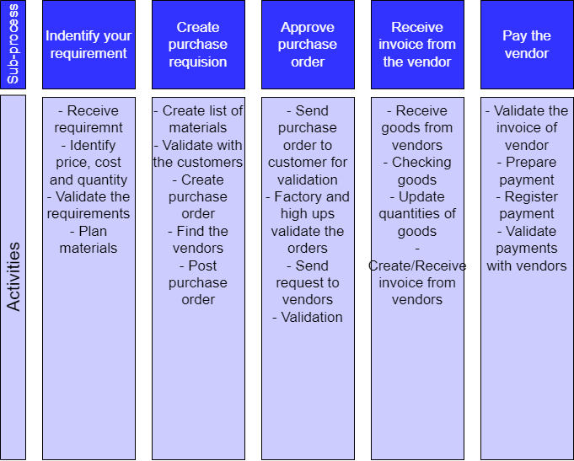
Make to Stock

Slide 8
Purchase Process

Slide 9
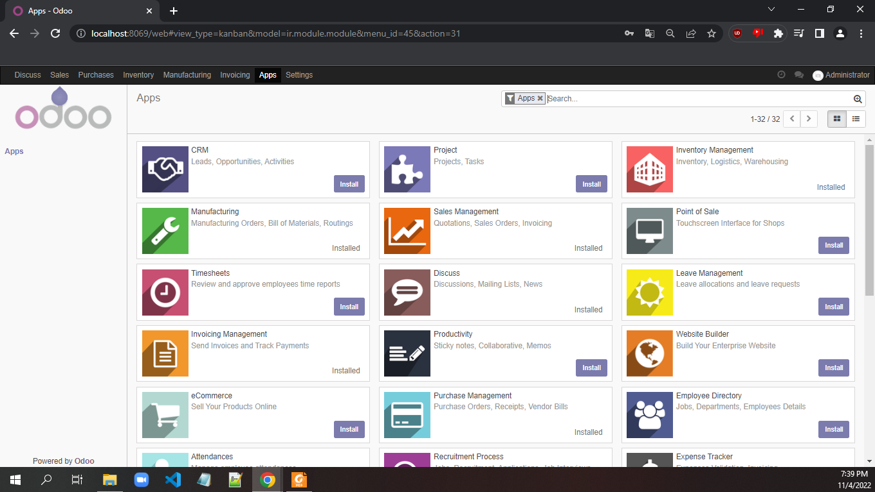

Slide 10
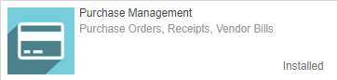
Download Purchase Module

Slide 11
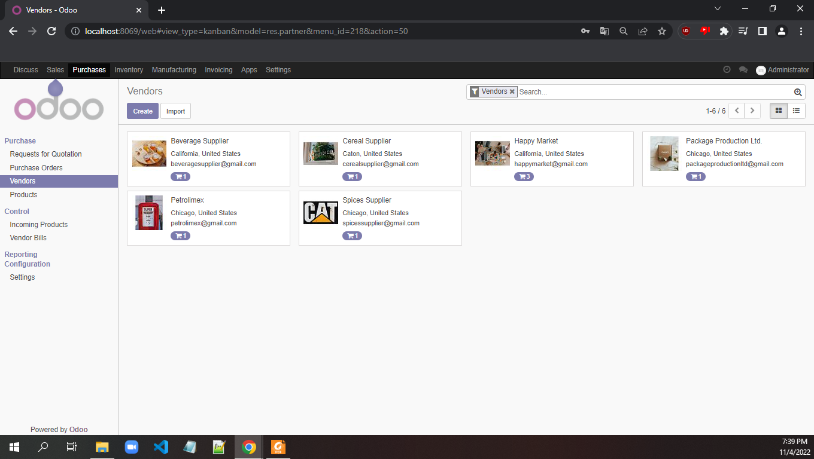
1/ Go to tab Products 2/ Under Purchase click Vendors
3/ Create Vendor

Slide 12
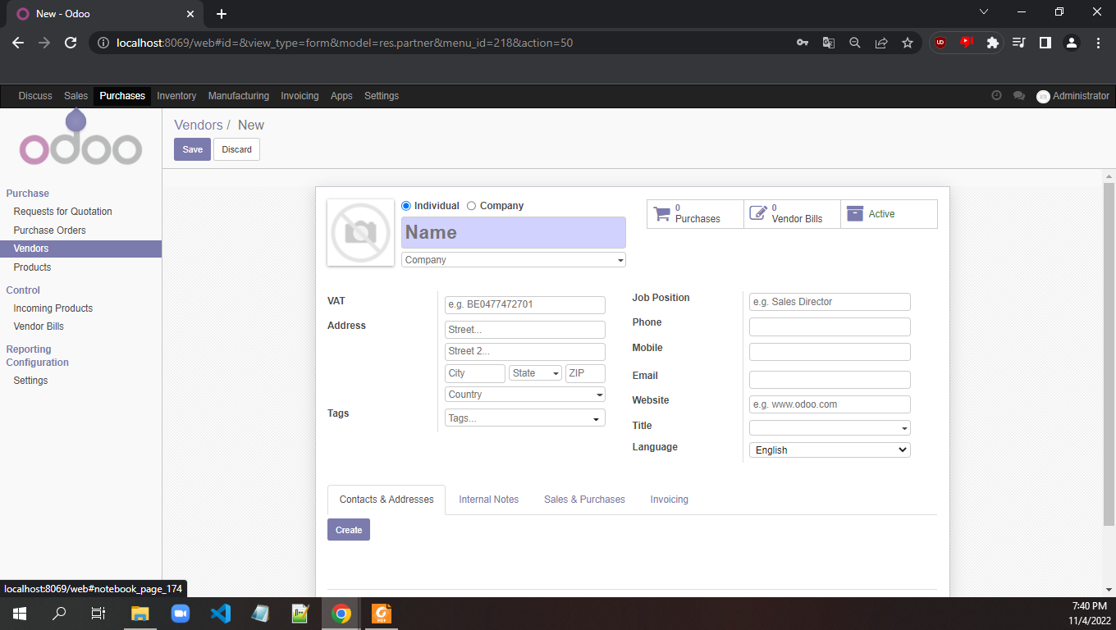
1/ Must fill Name and decide this Vendor is a Individual or a Company
2/ Fill out the other information
1/ Check the Sales & Purchase tab
2/ Check the Invoice

Slide 13
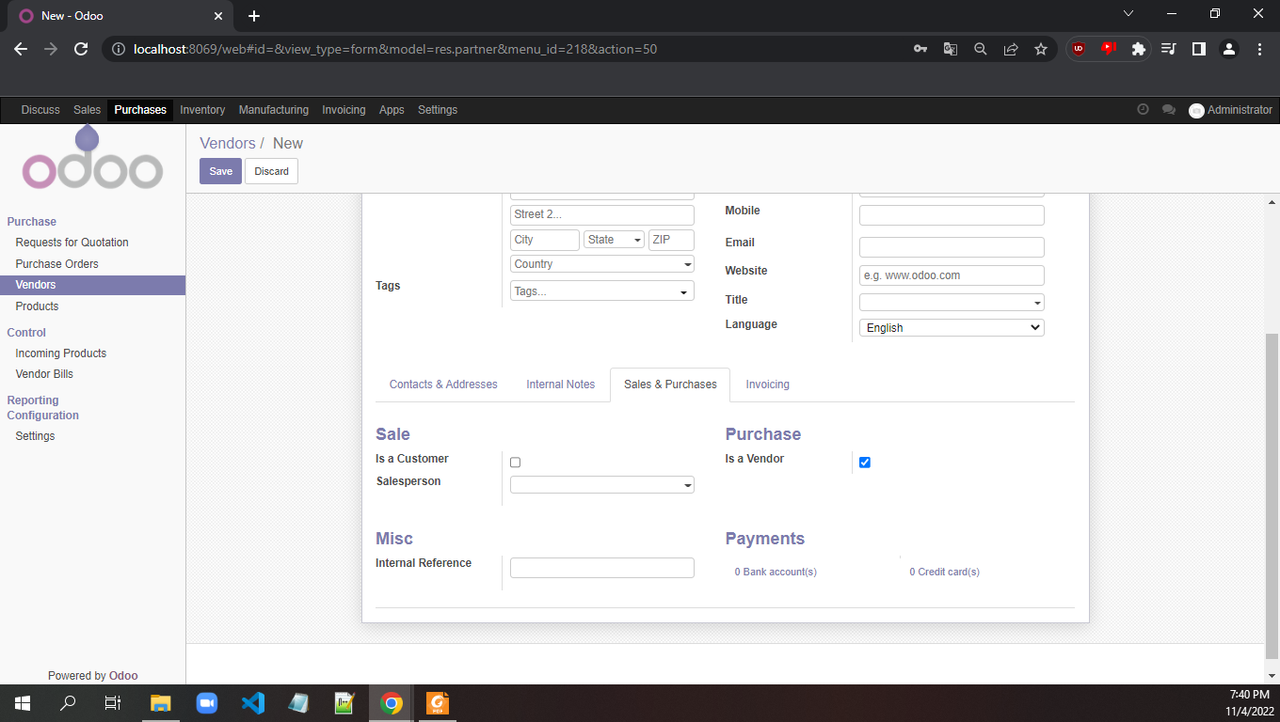
1/ Within the Sales & Purchase tab check under Purchase as Is a Vendor

Slide 14
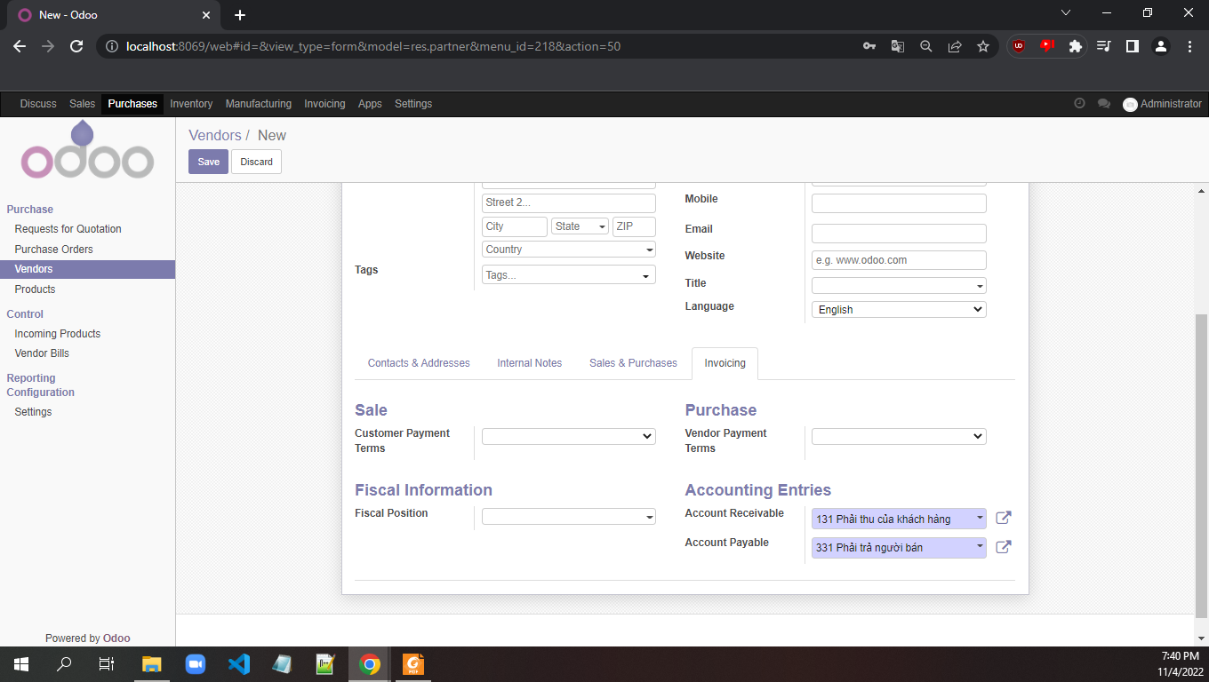
1/ In Invoicing tab, choose for both Sale > Customer Payment Terms and Purchase > Vendor Payment Terms as 15 days

Slide 15
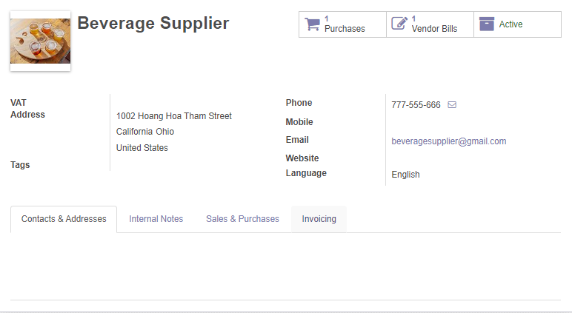
1/ This is our vendor with all the information filled out

Slide 16
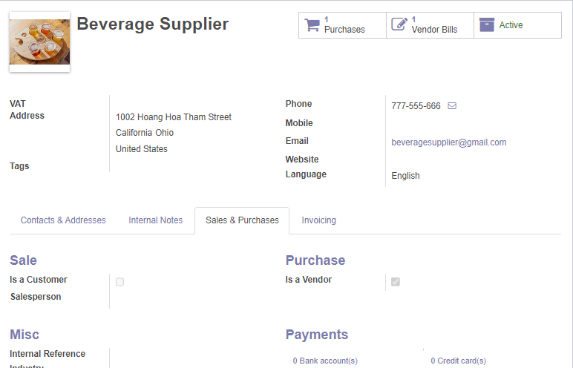
1/ This is our vendor with all the information filled out in Sales & Purchases tab

Slide 17
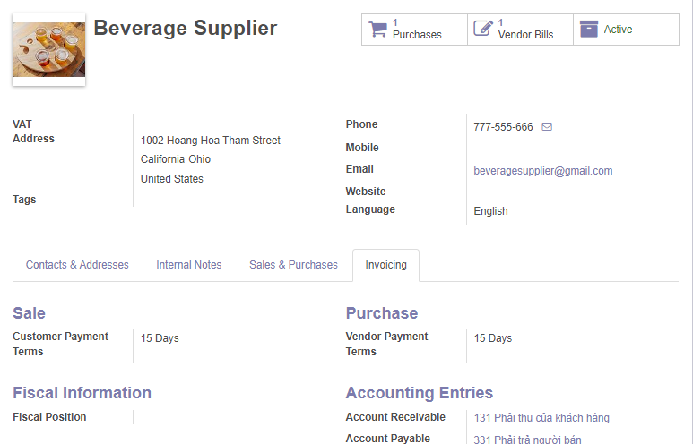
1/ This is our vendor with all the information filled out in Invoicing

Slide 18
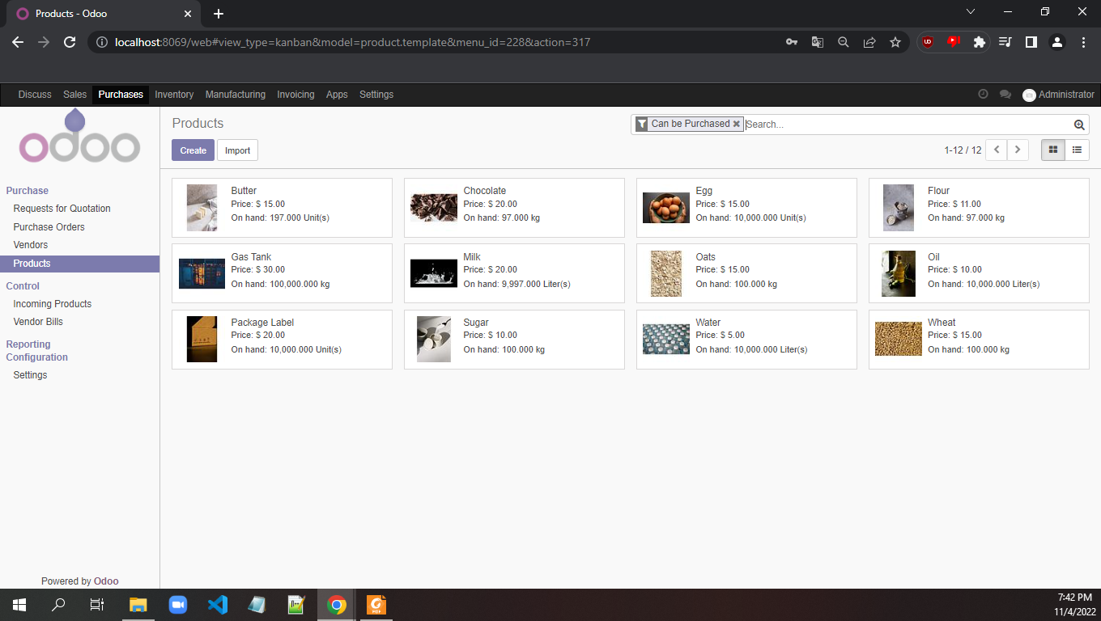
1/ We now create our product by going to Products tab and click Create

Slide 19
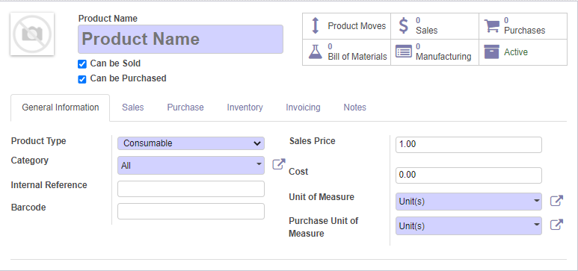
1/ We fill out information for our product
2/ Remember to uncheck the Can be Sold be cause this is a material

Slide 20
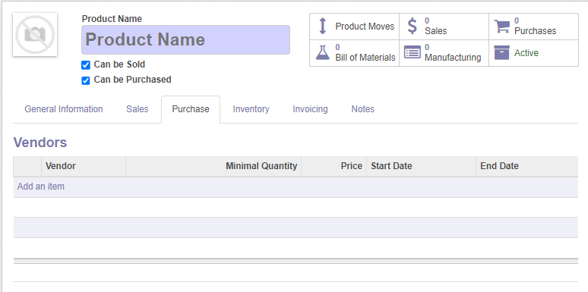
1/ In tab Purchase, we will add our vendor that we previous created

Slide 21
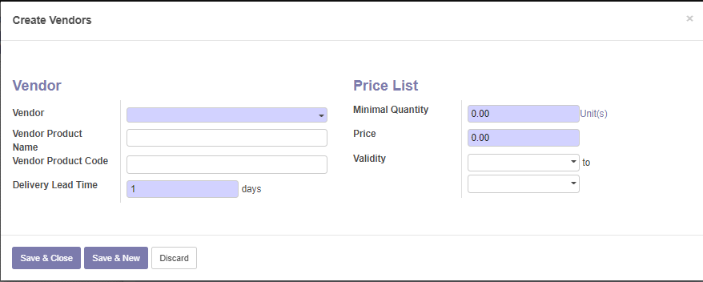
5/ Price list > Minimal Quanity, the minimum quantity that we shall import from this vendor
6/ Price of a single unit that we import from this vendor (note: product but different price based on the vendor)
1/ Choose the vendor
2/ Choose the product that this vendor supplies (you should create based on the name of the material that this vendor supplies)
3/ Type vendor code
4/ Lead time, is time process, we should leave at 4 days

Slide 22
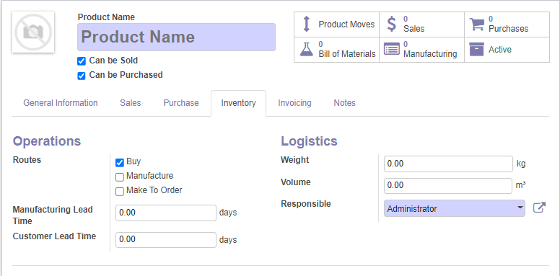
1/ In the Inventory tab, we choose only the Buy route because we gonna buy these material to create a product

Slide 23
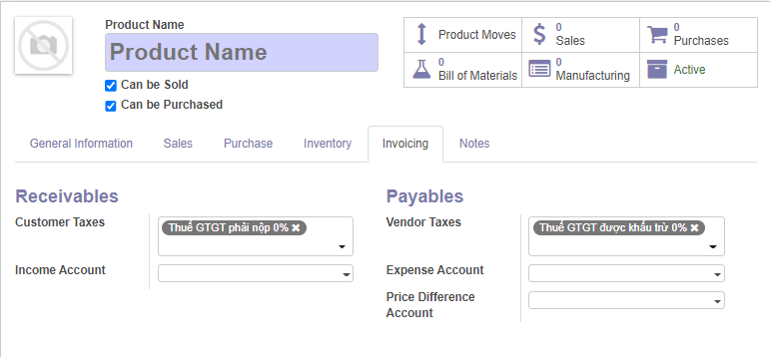
1/ In Invoicing, we choose the tax, we will give both Receivables and Payables both 5% tax

Slide 24
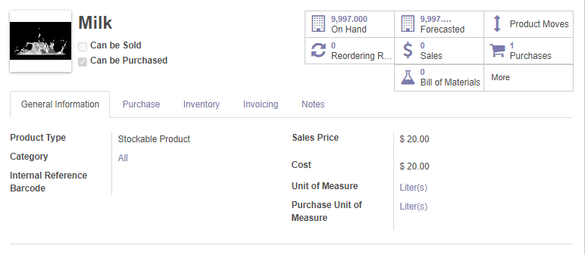
1/ This is the finished material page

Slide 25
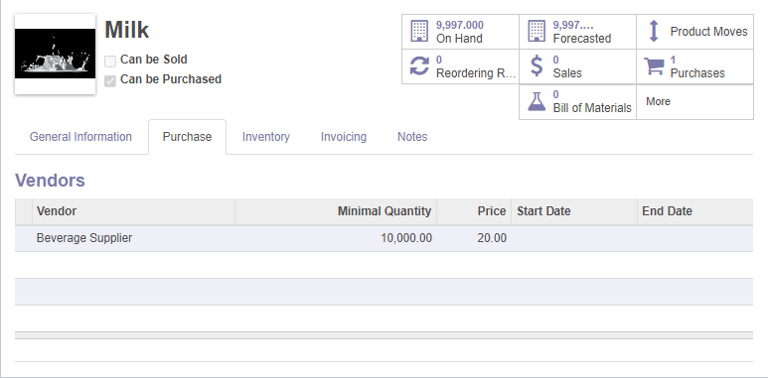
1/ We added our vendor is Beverage Supplier

Slide 26
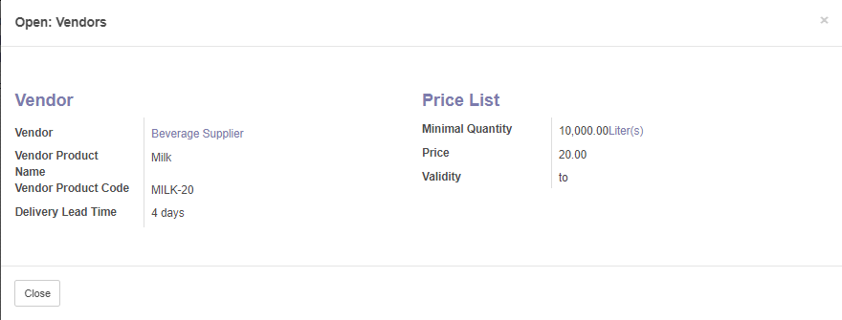
1/ Our vendor have the information on the left
2/ It also have the price per unit and quantity each import

Slide 27
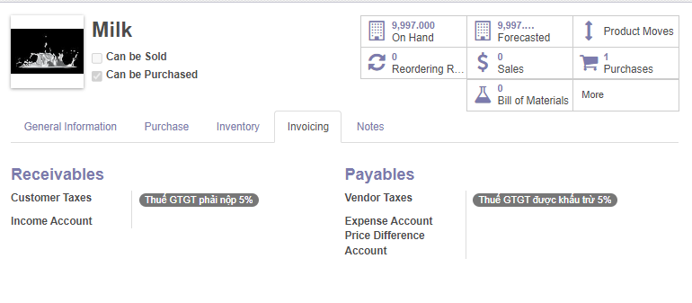
1/ In Invoicing tab, we have our taxes at 5%

Slide 28
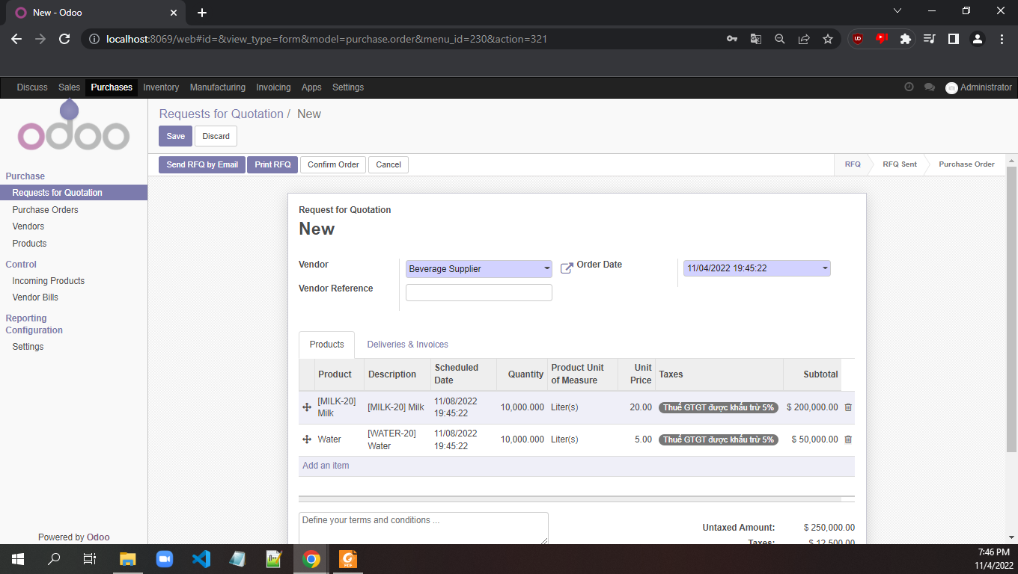
1/ We start to purchase the materials by choosing Requests for Quotation
2/ We choose Vendor and add Products
3/ Click confirm order to confirm

Slide 29
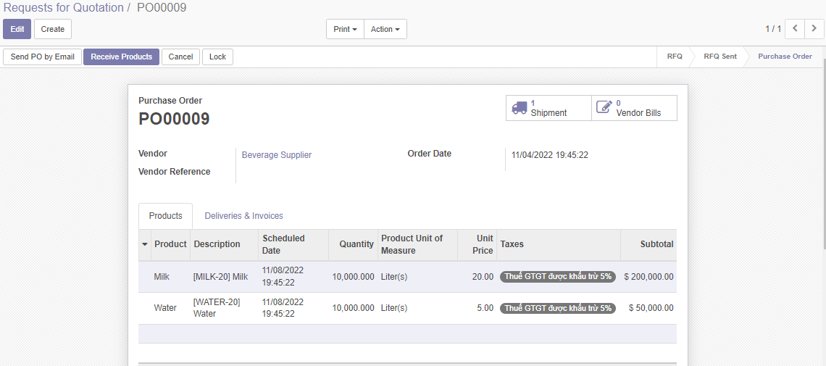
1/ After requests, we choose receive products

Slide 30
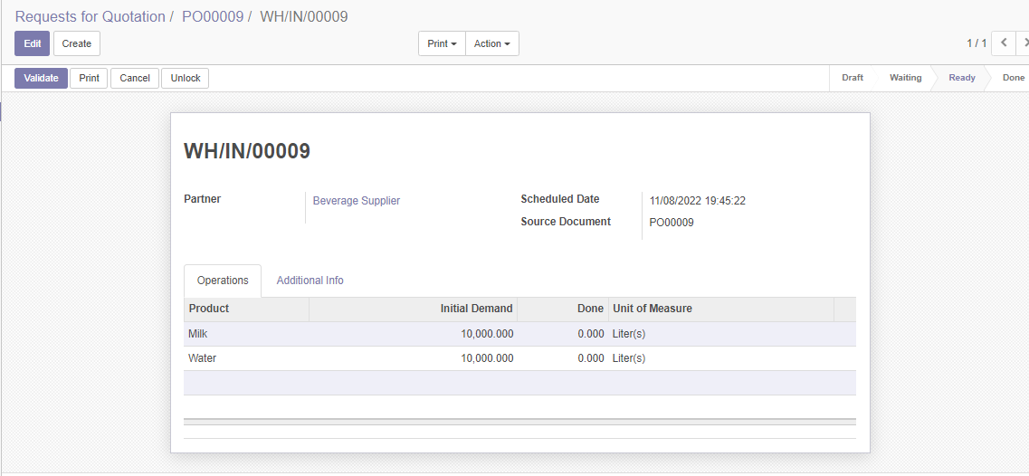
1/ We will check the quantities of materials
2/ We click Validate after checking
3/ The Done column will be auto filled after clicking validate

Slide 31
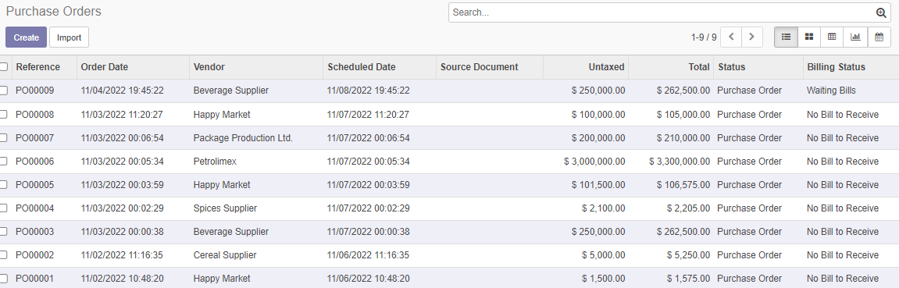
1/ We see that in Purchase Orders will have a new order
2/ But Billing Status is Waiting Bill because although we receive the materials but we have not pay the vendors

Slide 32
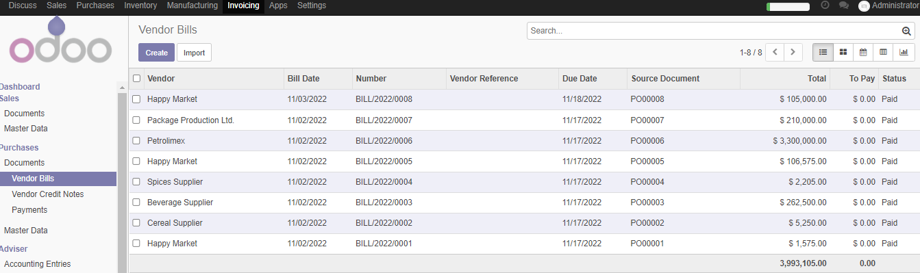
1/ Go to Invoicing > Under Purchases > Vendor Bills > click Create to create new Vendor Bill

Slide 33
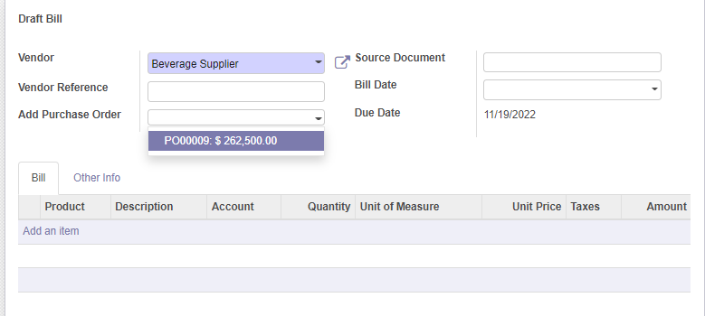
1/ We choose the vendor we want to pay
2/ Odoo will automatically check for any Pos that is currently unpayed and suggest, for example, this time Beverage Supplier has a PO00009 that is currently unpayed
1/ Odoo will automatically fill out the items that are in the bill

Slide 34
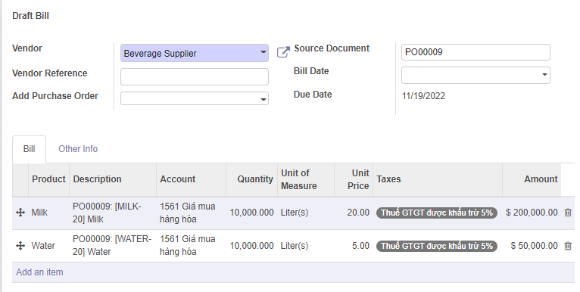
1/ This is the complete draft bill, containing Name of the vendor, PO of the vendor that is currently unpayed and materials of that bill

Slide 35
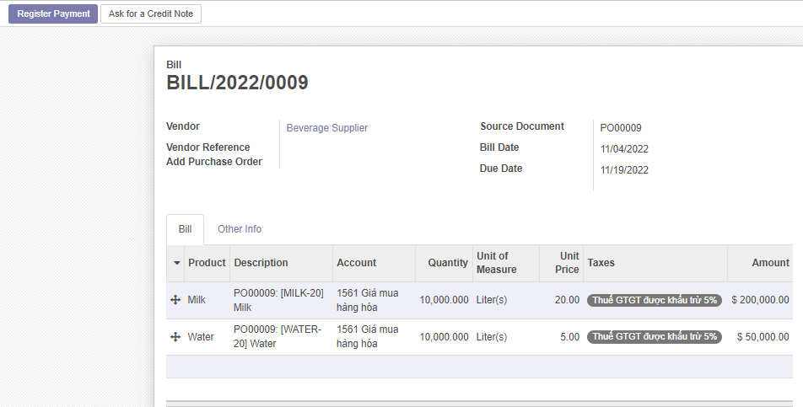
1/ We click register payment to register our payment for our vendor

Slide 36
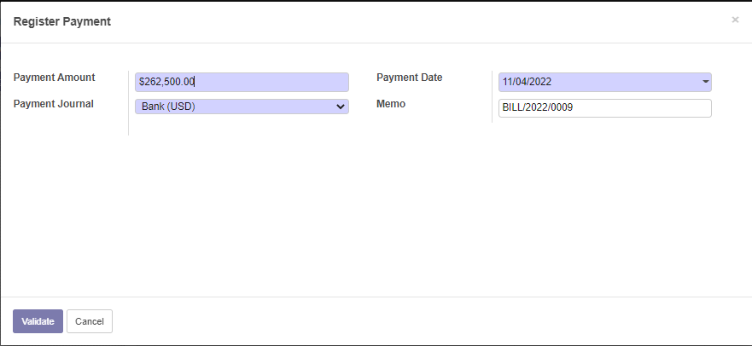
1/ Odoo will automatically display the amount we need to pay
2/ We choose the payment method, this time we choose the Bank method
3/ After that, we Validate Payment

Slide 37
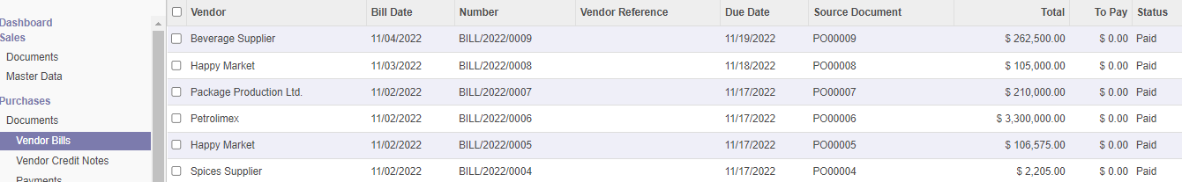
1/ After that, we check Vendor Bill and see that the bill for Beverage Supplier has been paid

Slide 38
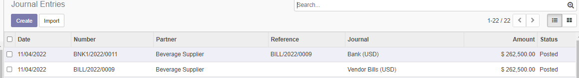
1/ A more detail payment can be found in Invoicing > Advisor > Journal Entries
2/ Beverage Supplier got a bill and a bank for that bill

Slide 39
Manufactoring

Slide 40
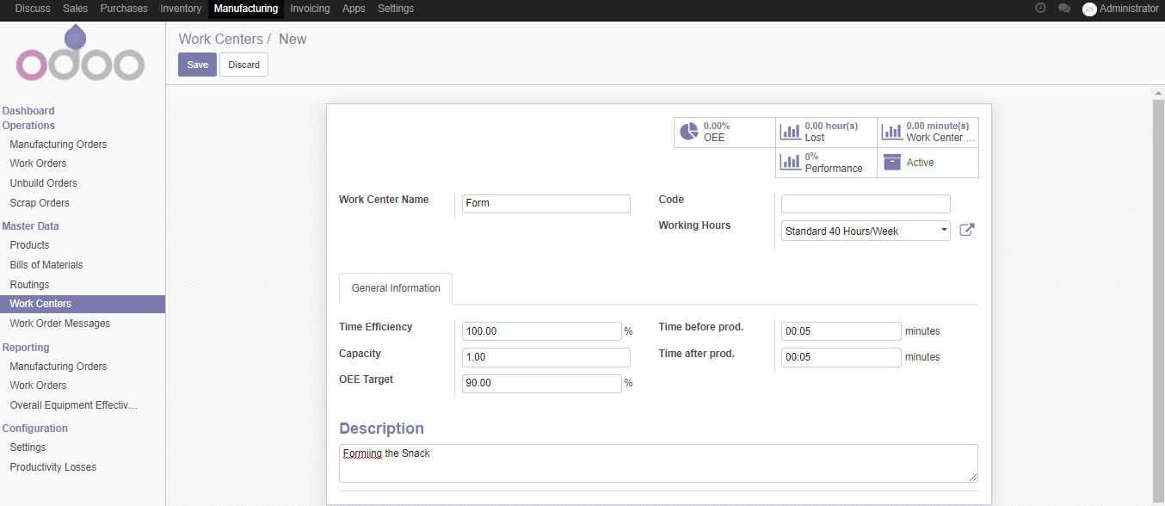
1/ Before we start Manufactoring, we will create a Work Center, these are processes for our production line
2/ We have 3 process called Form, Bake and Package
3/ Remember to add the code for

Slide 41
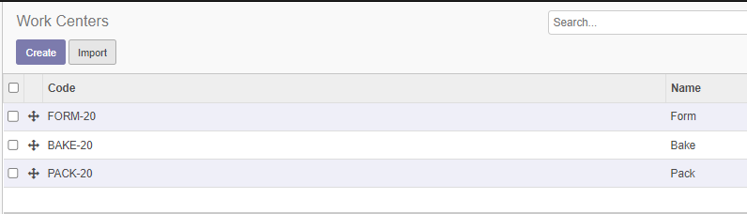
1/ After create individual work center, we have a list of Work Centers

Slide 42
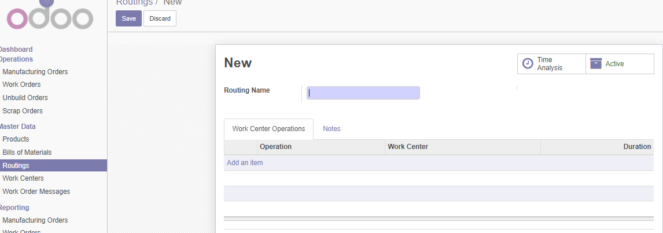
1/ We add the name as Snack production line
2/ After we have a list of Work Centers, we add all our Work Centers in Add an item

Slide 43
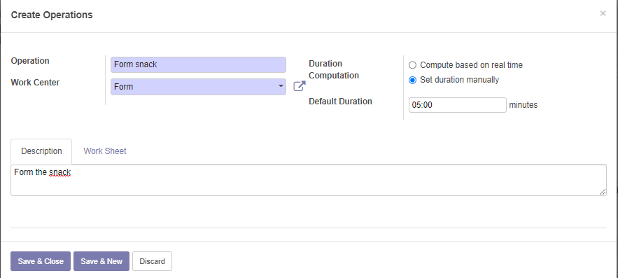
1/ This is the window to add the Work Center Form, we add the name Form snack
2/ Set the Duration as Manual
3/ We add the Description for this Work Center to this Route

Slide 44
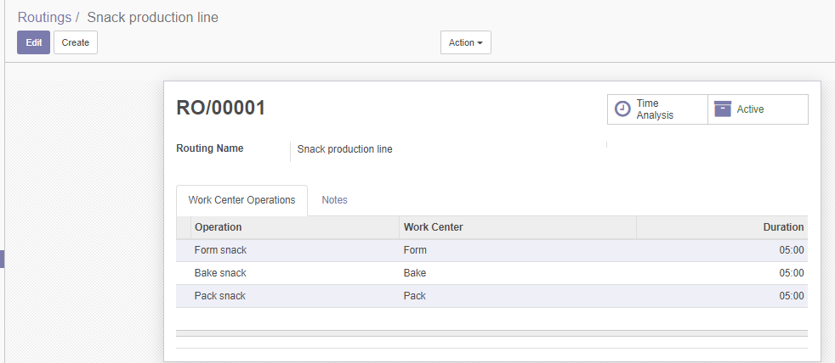
1/ This is the completed Route with 3 Work Centers, and it is called Snack production line

Slide 45
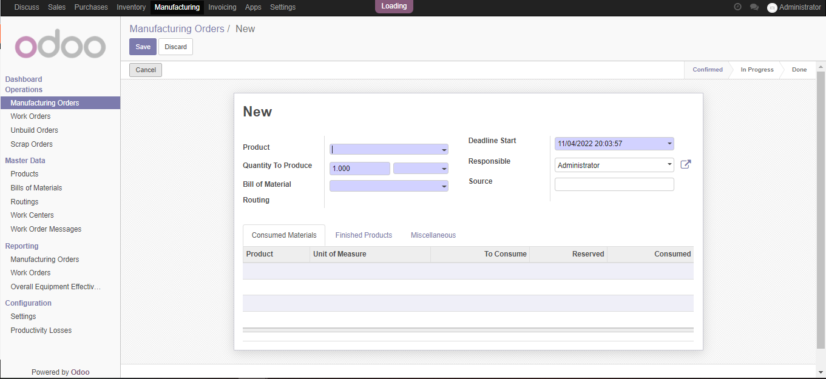
1/ We then create a manufacturing order by go to Manufactoring > Manufactoring Orders > Create
2/ Choose Product > Create and Edit to create a new product
3/ Quantity to Produde is the number of snack we want to produce (it will be adjusted automatically)
4/ Bill of Material will be added and Routing will be added in BOM

Slide 46
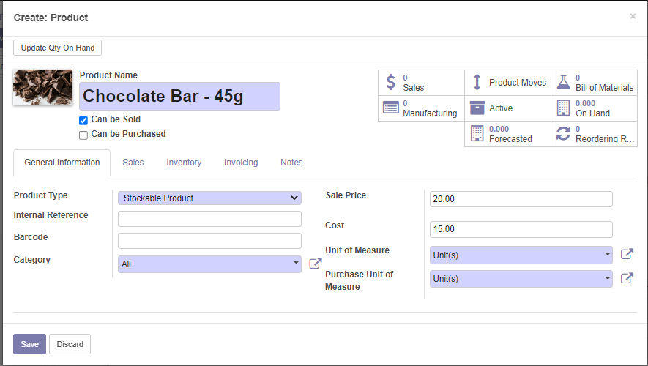
1/ This is create product for manufacturing
2/ Other information is the same as purchases so you do the similar
3/ Remember to uncheck the Can be Purchased and leave only Can be Sold checked

Slide 47
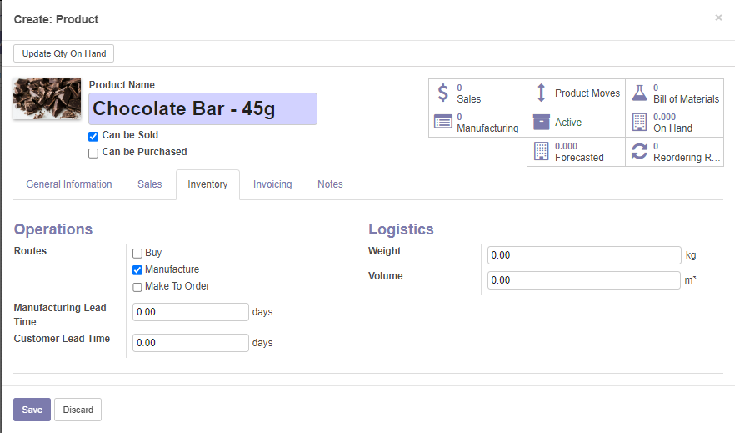

Slide 48
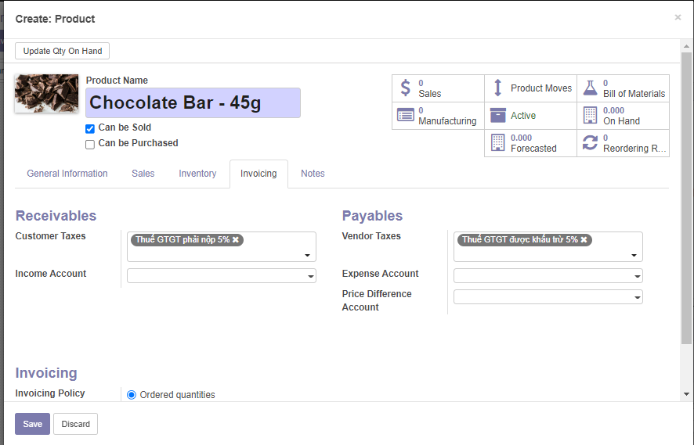

Slide 49
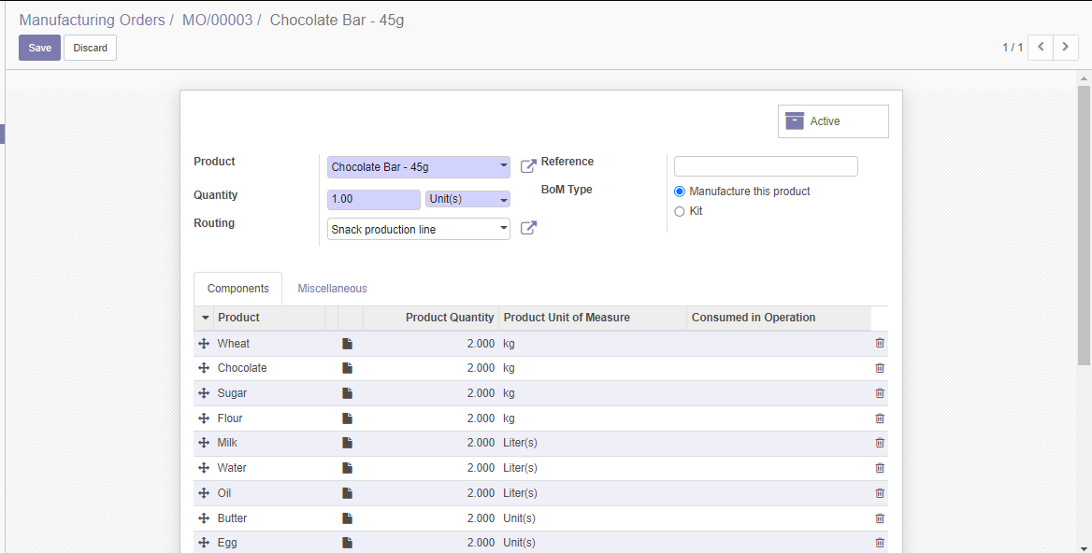
1/ This is the Bill of Material page, we add the product (the one we previously created), we add the quantity (how much should this line product at a time), routing we choose the Snack production line that we created before
2/ We add the list of materials in the line below
3/ We then save this Bill of Material

Slide 50
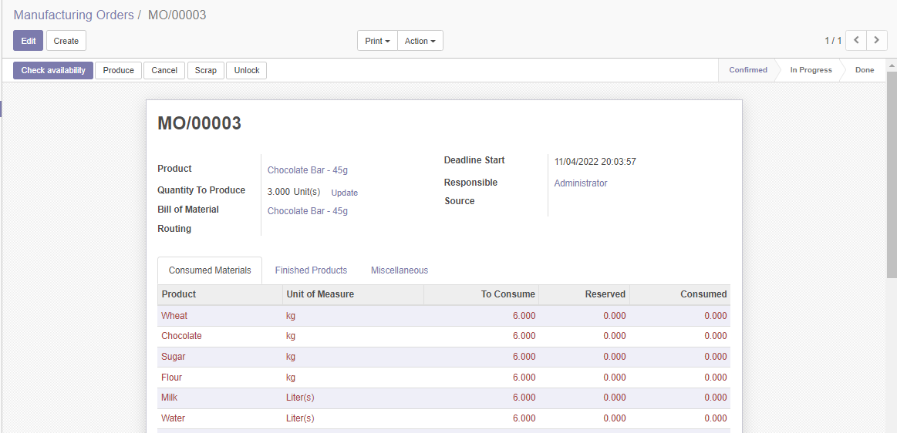
1/ This is the page after we finished, we need to check the availability for the reserved
2/ If we don’t have enough in the reserve, Odoo will not allow check availability, we need to add to go to purchase and buy the materials

Slide 51
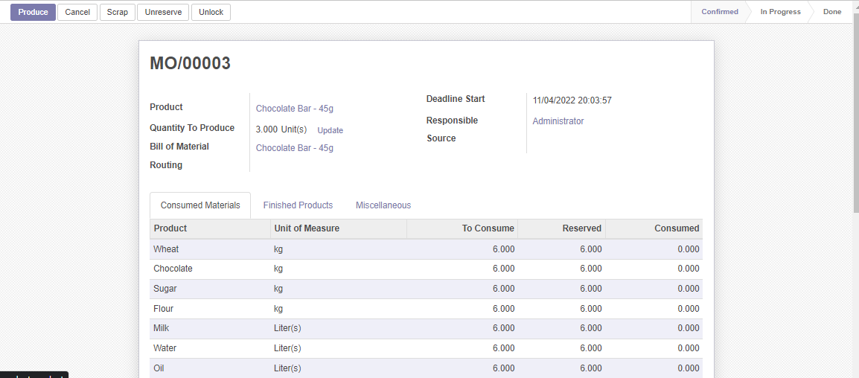
1/ After validation the text turn red to black
2/ We also have a Produce button
3/ Check the progress bar and see that we are on Confirmed

Slide 52
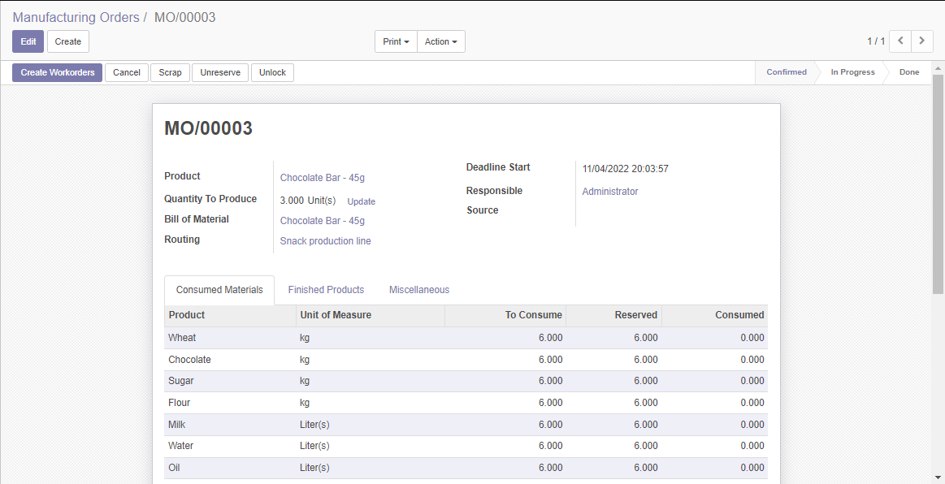
1/ This time after Produce, we move to the next which is Create Workorders

Slide 53
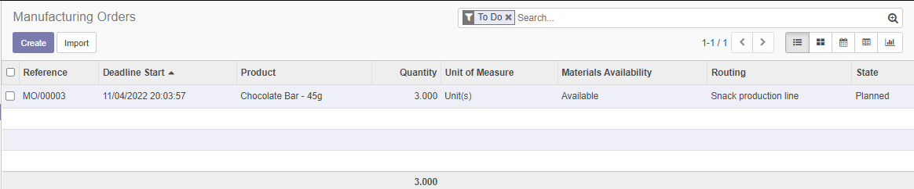
1/ This is the manufacturing orders, if we notice, we will see that the status is now planned
2/ We need to the Work Orders tab in the manufacturing to continue

Slide 54
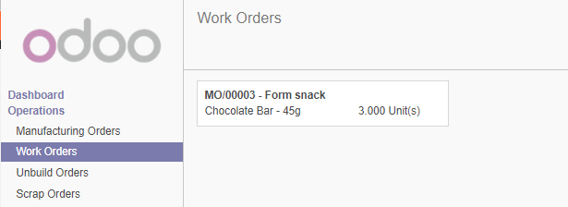
1/ In Work Orders, we see that we have an order for Form snack

Slide 55
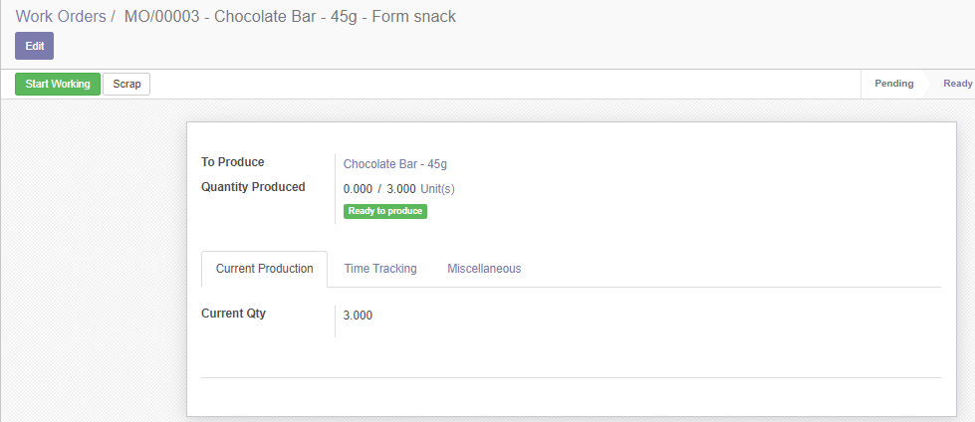
1/ With Form snack Work Order, we start the working process

Slide 56
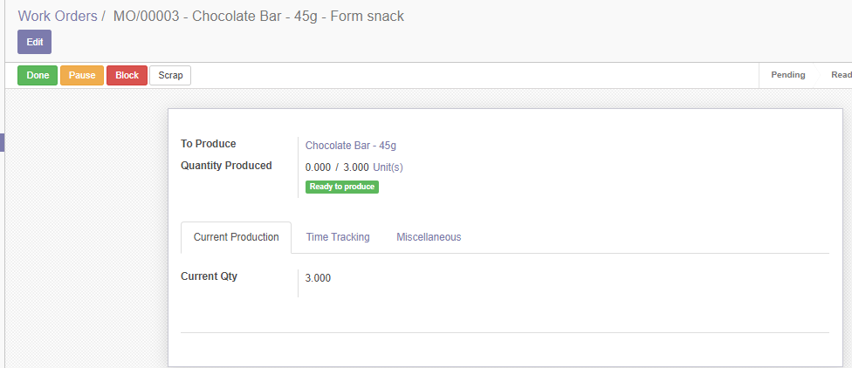
1/ This is the process of Forming snack
2/ Click done the finish the process

Slide 57

1/ This is the finished process, check the status below this notice, we see that it is Finished

Slide 58

1/ Although it is finished the manufacturing is not finished, it is still In Progress because we need to still have 3 other processes

Slide 59

1/ This is the Bake snack process, we process is the same as the previous one so we will not talk about the process

Slide 60


Slide 61

1/ This is the Pack snack process, we process is the same as the previous one so we will not talk about the process

Slide 62


Slide 63

1/ The manufacturing is now completed with 3/3 work order and a Mark as Done button now appeared

Slide 64

1/ We check the inventory by going to Inventory tab > Reporting > Inventory Valudation > Retrieve the inventory valudation

Slide 65

1/ We see that we have Chocolate Bar – 45g with 3 unit cost about 45$

Slide 66

1/ The manufactured product also appeared in Sales > Products

Slide 67
1/ This the manufacturing process for Oats Bar – 40g, the process is similar so we will omitted from talking about the process but show pictures to demo

Slide 68


Slide 69


Slide 70

1/ Notice the Bill of Material is the different in the ingreedients

Slide 71


Slide 72

1/ It costs 2kg of each to create a 1 unit of Oats Bar, we need 3 units so Odoo automatically calculate for us to 6kg

Slide 73


Slide 74


Slide 75

1/ After finished, we have Chocolate Bar and Oats Bar

Slide 76
Setting Website

Slide 77

1/ Create a website we choose the basic form

Slide 78

1/ Publish is to publish the page so other public user can see
2/ New is to new a page (we will have new product after we install eCommerce)
3/ Edit is to edit the current page we are in

Slide 79

1/ This is to edit the page
2/ Click save to Save and Discard to cancel changes

Slide 80

1/ After finished, we have Chocolate Bar and Oats Bar

Slide 81

1/ We are on Adminstrative account, we have also installed eCommerce that is why in the shop we have products in our sales loaded in our shop
2/ These products are not publish to the public user

Slide 82

1/ We can add new product that are not in Sales

Slide 83

1/ Add new product name

Slide 84

1/ To publish product from sales to public customer

Slide 85

1/ This is the view that public customer see after you set up publish

Slide 86
Sales Order via Sale Person

Slide 87

1/ Check products in Sales, we see that Chocolate Bar – 45g has 3 units, Oats Bar – 40g has 3 units 2/ We preform Sales order via sales person

Slide 88

1/ Sales > Quotation > Create

Slide 89

1/ Fill information for Customer 2/ Choose the product you want to sales which is Chocolate Bar - 45g, quantity is 1 units

Slide 90

1/ Confirm sales will create Quotation to Sales Order
2/ Create Invoice will create the invoice for Register Payment

Slide 91

1/ From Invoice, we validate the invoice, the invoice will be as draft

Slide 92

1/ The draft invoice turn from Draft to Open

Slide 93

1/ Register Payment to turn the invoice into Paid status

Slide 94

1/ Register Payment to turn the invoice into Paid status

Slide 95

1/ We check the quantity of Chocolate Bar – 45g is now reduced to 2 units

Slide 96

1/ Check the Journal Entries, we see that INV means there are sales and BNK means the customer banked

Slide 97
Sales Order via Website

Slide 98


Slide 99

1/ Go to the product on website

Slide 100

1/ Next we move to the Review Order

Slide 101

1/ Our customer is not in the database, so we need to fill in our public customer information

Slide 102

1/ Checking the Billing Address and Shipping Address of our public customer

Slide 103

1/ A customer is created and they have a new transaction

Slide 104


Slide 105

1/ This is the final page, thank you the customer for purchasing
2/ Notice Payment Information is pending, we will handle this

Slide 106

1/ In this, we see status is Quotation Sent

Slide 107

1/ From Quotation to Sales Order

Slide 108

1/ After we register payment and the status is now Paid

Slide 109

1/ Payment information is now updated to Done

Slide 110

1/ Our Oats Bar is now reduced to 2 units

Slide 111
Sales Order via Point of Sales

Slide 112

1/ Install POS

Slide 113

1/ Create new session for the cashier

Slide 114

1/ Register Payment to turn the invoice into Paid status

Slide 115

1/ The cashier choose the product, select the customer and choose payment

Slide 116

1/ Customer gives cash and Cashier into and return change back to the Customer

Slide 117


Slide 118

1/ This is the next customer and the process repeated until the Cashier end their session

Slide 119


Slide 120


Slide 121

1/ Here is the order of the Cashier process

Slide 122

1/ This is end the process and post the entries

Slide 123


Slide 124

1/ This is the process include the customer and the totol bill of the Cashier session

Slide 125


Slide 126
Make to Order

Slide 127
The University of Chicago wants to order about 1 unit worth of Oats bar - 40g
Operations:
University of Chicago contacts Fitter Snacker, argree on the amount of Oats Bar that University of Chicago need
Fitter Snacker plans the BOM and orders the materials
Fitter Snacker paid the vendors
Fitter Snacker receives the materials
Fitter Snacker manufactures products based on the BOM
Fitter Snacker informs the University of Chicago
Fitter Snacker delivers 1 unit of Oats Bar to University of Chicago
Fitter Snacker creates invoice for University of Chicago
Fitter Snacker register payment for University of Chicago
Fitter Snacker saves University of Chicago information

Slide 128

1/ Check the make to order to turn on make to order

Slide 129

1/ Create the Quotation

Slide 130

1/ From Quotation to Sales Order

Slide 131

1/ The Sales Order has waiting another operation, this only created when the make to order is checked for a product

Slide 132

1/ We need to go to Manufacturing, there we see an MO already created and waiting

Slide 133

1/ We repeated the process of manufacturing that we have done previously

Slide 134


Slide 135

1/ We repeated the process of Work Order that we have done previously, until the Work Orders is 3/3

Slide 136

1/ Mark as Done to complete

Slide 137


Slide 138

1/ We go back to Sales Order and see that the Waiting Another Operation is now moved to status Ready 2/ We continue the Sales Order process similar to previous

Slide 139


Slide 140


Slide 141


Slide 142


Slide 143

1/ We register the payment method

Slide 144

1/ The Sales Order is now status paid

Slide 145

1/ We check the inventory we notice that the quantity stayed the same because Make To Order ignore your quantity reserve although you have enough product, it will make you make more for Make To Order

Slide 146

1/ Check Journal Entries we see that University of Chicago has Make To Order and they have paid

Slide 147

1/ Detailed of Sales Order

